Slide 1

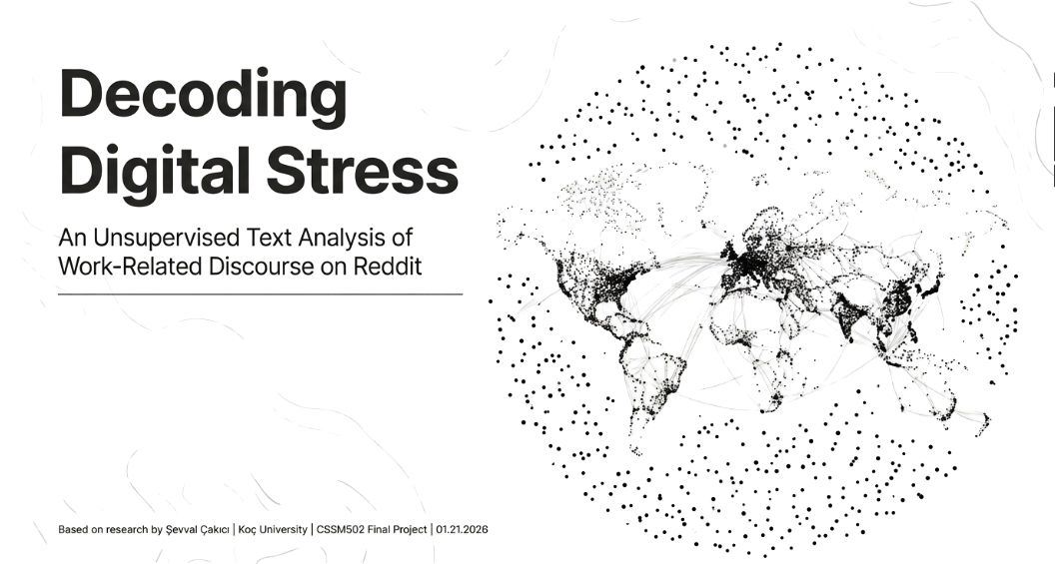


Exploring Work-Related Stress Through Unsupervised Text Analysis on Reddit
Şevval Çakıcı
CSSM502, 22 Jan 2026

Slide 2
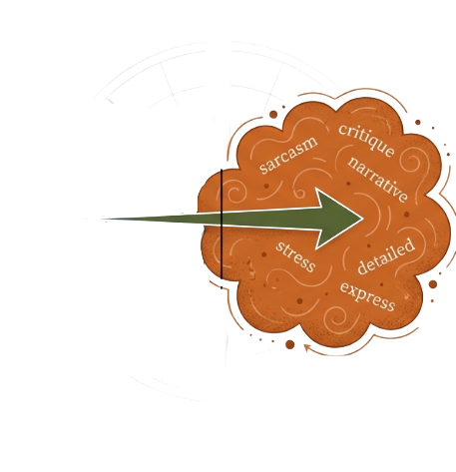
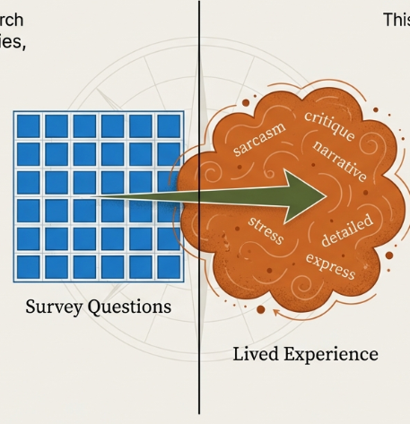
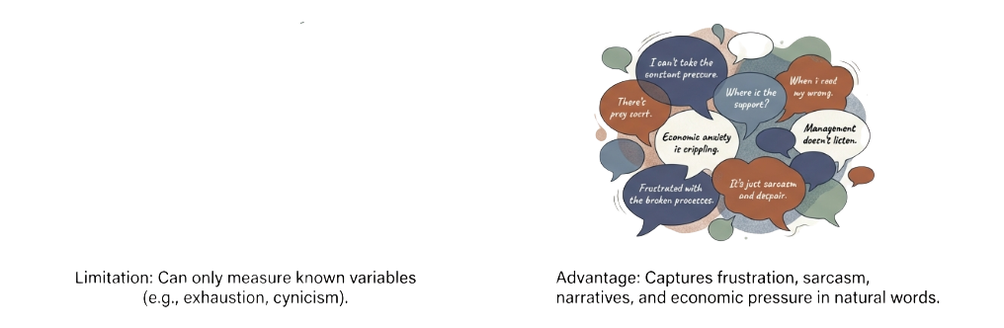

The Limits of Structured Inquires
Lived Experience
(Natural Expressions)
Survey Questions
(Fixed Categories)

Slide 3
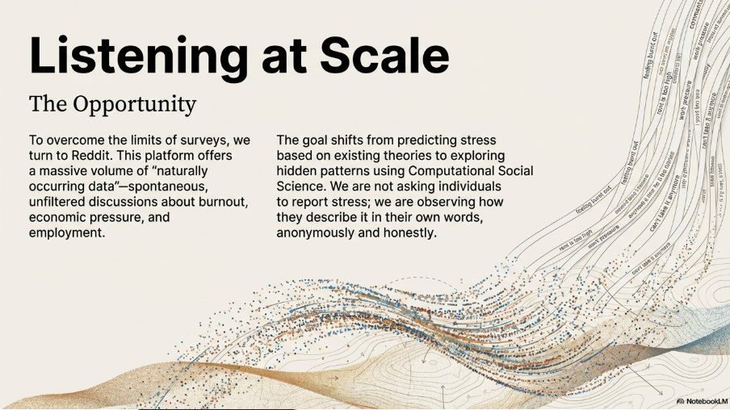

Listening at Scale
To overcome the limits of surveys → Reddit
Not asking individuals to report stress
Observing how they describe it in their own words
Anonymous and honest

Slide 4
What I Expect to Find
Discussions about work related stress are not all the same. Instead, they are likely to form several distinct groups that reflect different aspects of work, such as economic insecurity, workplace relationships, trust in institutions, and emotional exhaustion.
These groups will only partly match established psychological theories of stress, like Lazarus Cognitive Appraisal Theory. This suggests that everyday language captures parts of stress that go beyond set theoretical categories.
Unsupervised text analysis can uncover hidden patterns in how people describe and understand work-related stress. It also aims to show the limits of using only data driven methods to capture personal experiences.

Slide 5
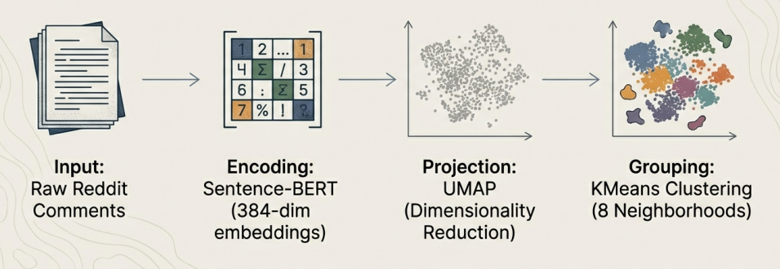
Analytical Steps
Transformed 10,000 comments into a semantic map without losing context.

Slide 6
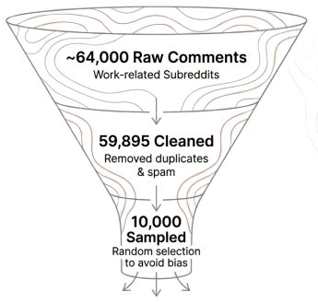
Refining the Dataset
High volume data requires careful curation to ensure analytical validity.
A turkish langugae dataset was originally collected but excluded due to “thematic noise” (profanity, pop culture) to preserve the integrity of the analysis.

Slide 7
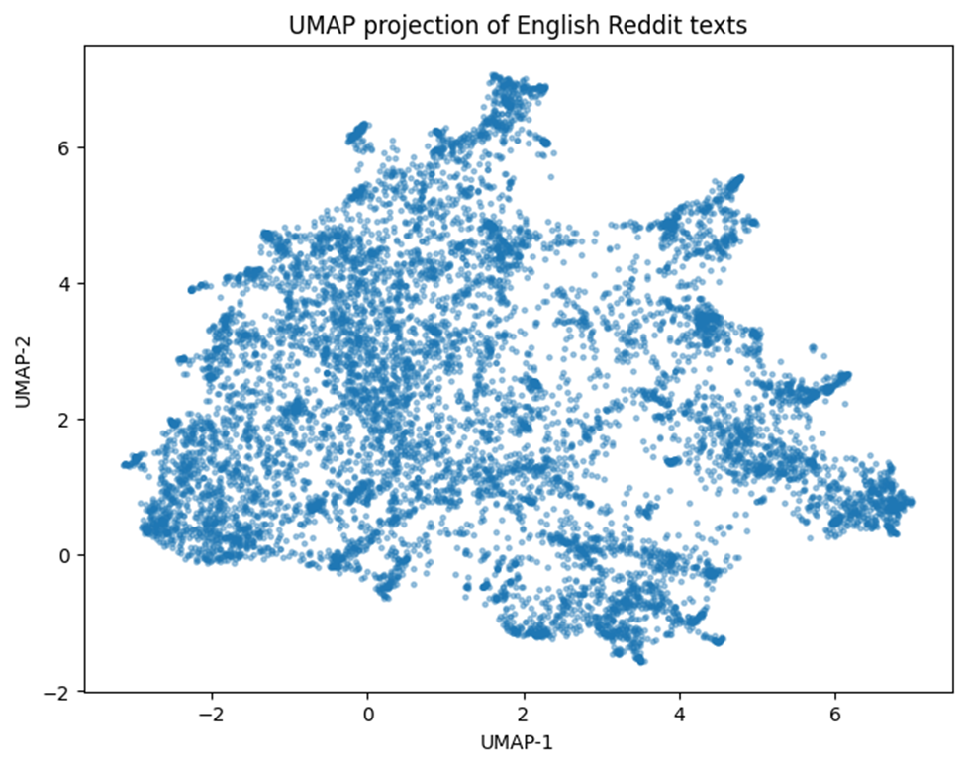
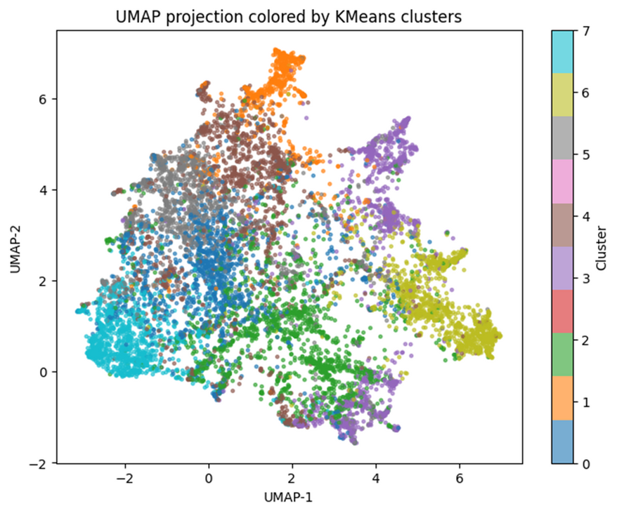
The Topography of Work Related Stress
Figure 1. UMAP projection of 10,000 English Reddit comment embeddings. Each point represents a comment encoded using Sentence-BERT. The visualization reveals multiple locally dense regions, suggesting the presence of distinct latent semantic structures.
Figure 2. UMAP projection colored by KMeans cluster assignments (k = 8). While some clusters form compact and well-separated regions, others exhibit partial overlap, reflecting the fuzzy boundaries of work-related discourse themes.

Slide 8
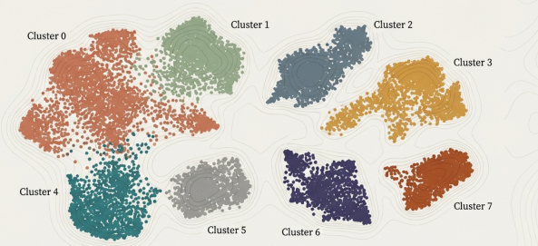
The Topography of Work Related Stress
The analysis revealed 8 distinct clusters. Boundaries are fuzzy; personal stress bleeds into political and economic frustration.

Slide 9
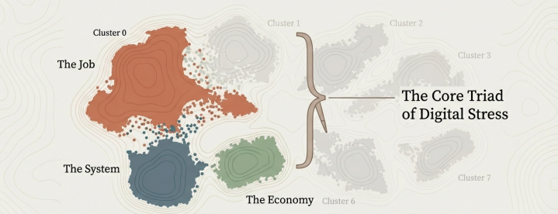
Identifying the Signal
Out of 8 clusters, qualitative inspection revealed three core “work related stress” zones. 86.5% of texts in these zones contained work, economy, and stress related terms.

Slide 10
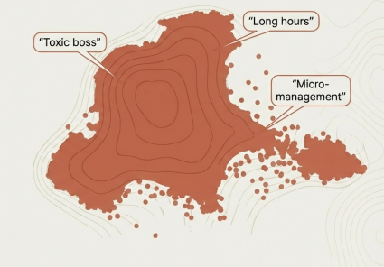
Cluster 0: The Daily Grind
Theme: Workplace Attitudes & Job Experiences
This cluster respresents the most direct form of work stress. It centers on dissatisfaction with working conditions, management practices, and job security.
Key Descriptors: Management practices, job security, workplace conditions.

Slide 11
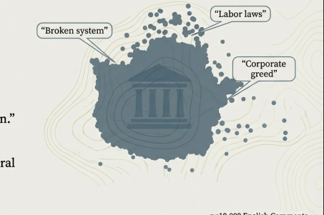
Cluster 4: Institutional Critique
Theme: Structural Injustice & Social Frustration
In this cluster, stress is externalized. The discourse moves away from personal grievances to broader social frustration. It is not just “I am tired”, it is “The system is broken”.
Key Descriptors: Political systems, labor markets, structural injustice.

Slide 12
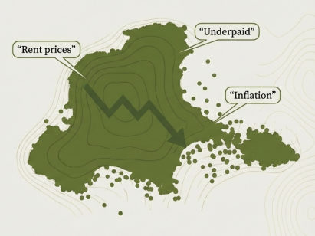
Cluster 5: The Economic Weight
Theme: Inequality & Material Precarity
This cluster is dominated by discourse on economic inequality. It emphasizes the gap between effort and reward. It is the stress of survival.
Key Descriptors: Cost of living, financial strain, inequality.

Slide 13
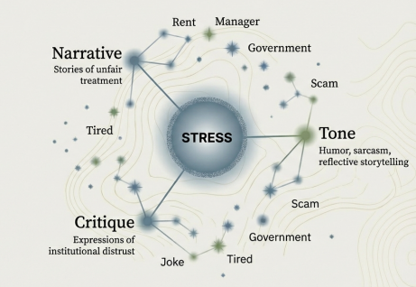
Stress is a Chameleon
People rarely say “I am stressed” in a way that fits a survey box. Work related stress is articulated through multiple discursive modes.

Slide 14
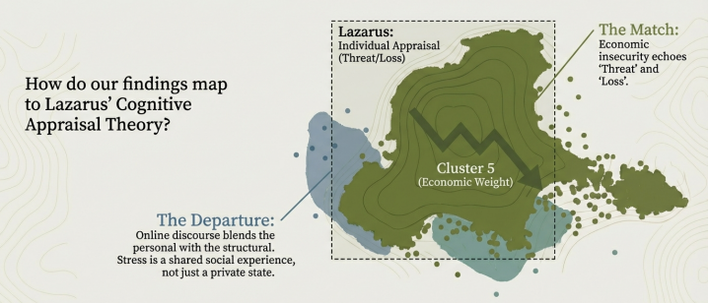
Re-visiting the Theory
How do findings map to Lazarus Cognitive Appraisal Theory?

Slide 15
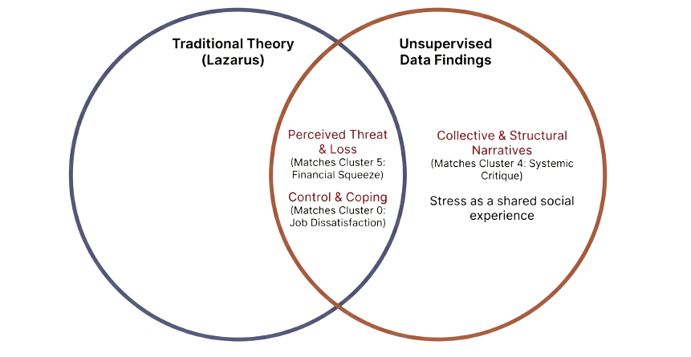
Re-visiting the Theory

Slide 16
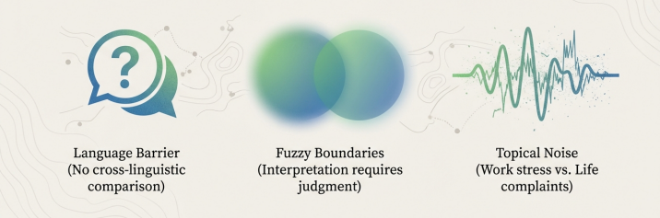
Limitations

Slide 17
Thank you

